Slide 1
Amazon Sales Data Analysis

Slide 2
Objective: To analyze Amazon sales data to identify key trends and insights.
Data Source: Amazon Sales Data CSV file.
Tools Used: Python, Pandas, NumPy, Seaborn, Matplotlib.

Slide 3
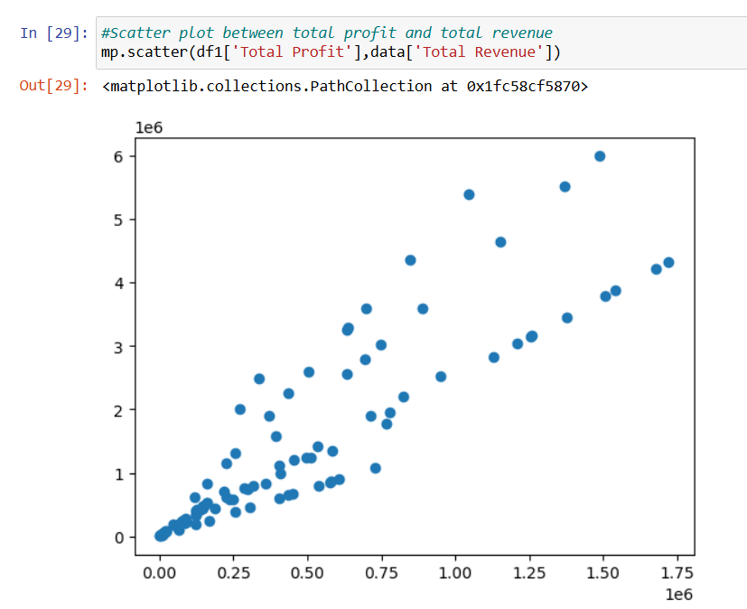
Data Visualization & Analysis
The scatter plot also suggests that total profit and total revenue are directly proportional to each other.

Slide 4
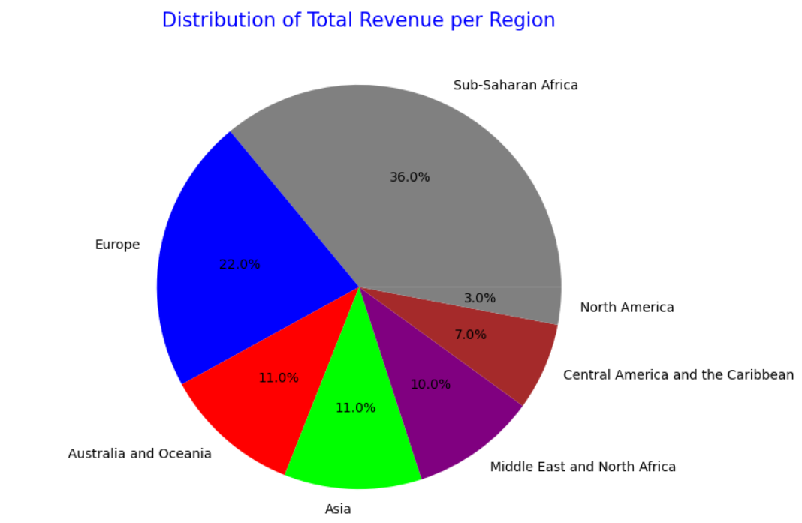

Slide 5
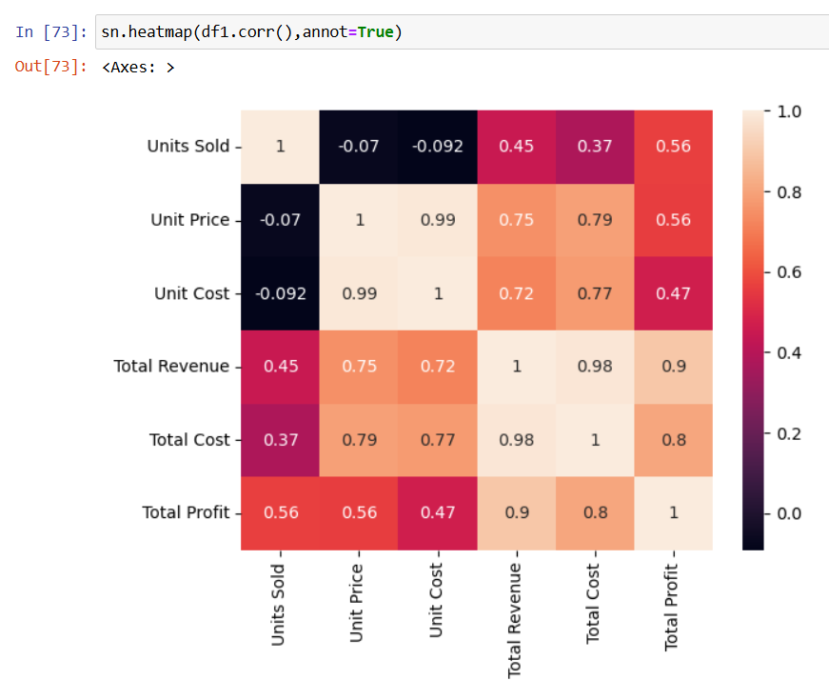
From the heatmap, we can infer that Total Cost is strongly related to Unit Price, Unit Cost and Total Profit.
Units Sold and {Unit Price and Unit Cost} are completely independent.
Unit Cost, Unit Price and Total Cost are almost completely independent of Total Revenue.

Slide 6
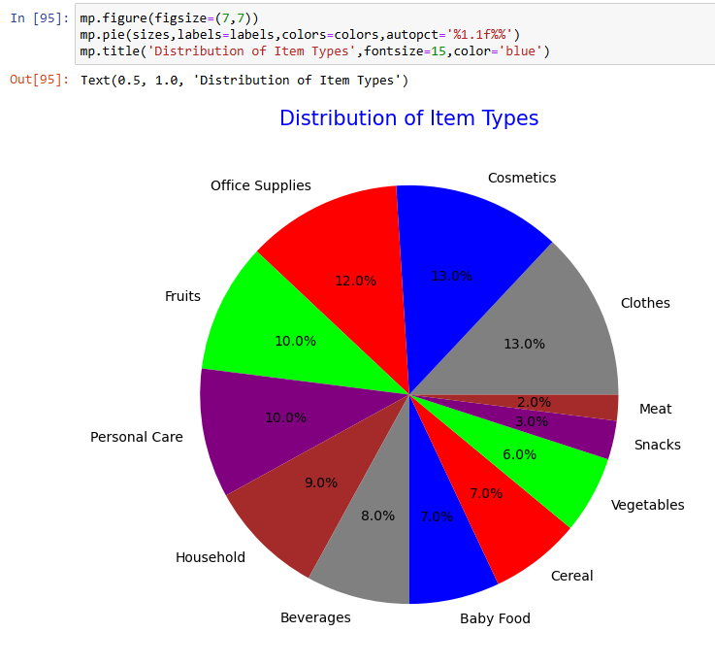
From the pie chart we can conclude that clothes and cosmetics are the most purchased items
while meat and snacks are the least purchased ones.

Slide 7
Key Findings:
Maximum profit generated in Sub-Saharan Africa.
Highest revenue from Clothes and Cosmetics.
2012 was a highly profitable year.
Office supplies had the highest unit cost.
Clothes and Cosmetics are the most purchased items.
Cost is highest in Asia and North America.

Slide 8
Thank You !

